Slide 1
CSCE 120/121
Inheritance, Polymorphism, and Virtual Functions
Dr. Tim McGuire
Some of the material and images from Bradley Kjell, Central Connecticut State University

Slide 2
What Is Inheritance?
Provides a way to create a new class from an existing class
The new class is a specialized version of the existing class
Notes:
Inheritance allows a new class to be based on an existing class. The new class inherits the member variables and functions of the class it is based on.

Slide 3
QUESTION
Instead of creating new classes from old classes by inheritance, why not copy the source code for the old class and change it to suit your needs?
This leads to problems.
If you need both the old class and the new, you now have two similar source files.
Notes:
If you have the source code for a class, you could copy the code and change it to do what you wanted. Before object oriented programming that was what was done. But there are at least two problems with this:
It is hard to stay organized. Say that you already have several dozen classes which you need to keep and that you need additional classes based on the original ones. Also, say that you need several classes based on the new classes. You will end up with dozens of source files which are all versions of other source files that have been changed in various ways. Now say that a bug has been found in one of the source files. Some source files based on it need fixing; others, perhaps not. Without careful planning you will end up with an disorganized, inconsistent, buggy mess. (I speak from experience, here.)
You need to study the original code. Say that you have a complicated class that basically does what you want, but you need a small modification. If you edit the source code, even to make a small change, you risk breaking something. So you must study the original code to be sure that your changes are correct. This may not be easy.

Slide 4

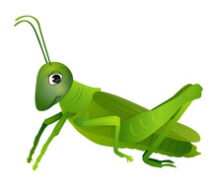
Example: Insects
Insect
All insects have certain characteristics
Images: public domain clipart
In addition to the common insect characteristics, the bee has its own unique characteristics such as the ability to sting.
In addition to the common insect characteristics, the grasshopper has its own unique characteristics such as the ability to jump.
Notes:
In the real world you can find many objects that are specialized versions of other more general objects. For example, the term “insect” describes a very general type of creature with numerous characteristics. Because grasshoppers and bumblebees are insects, they have all the general characteristics of an insect. In addition, they have special characteristics of their own. For example, the grasshopper has its jumping ability, and the bumblebee has its stinger.

Slide 5
The "is a" Relationship
Inheritance establishes an "is a" relationship between classes.
A poodle is a dog
A car is a vehicle
A flower is a plant
A football player is an athlete
Notes:
When one object is a specialized version of another object, there is an “is a” relationship between them. For example, a grasshopper is an insect. Here are a few other examples of the “is a” relationship.
A poodle is a dog
A car is a vehicle
A flower is a plant
A football player is an athlete
When an “is a” relationship exists between classes, it means that the specialized class has all of the characteristics of the general class, plus additional characteristics that make it special. In object-oriented programming, inheritance is used to create an “is a” relationship between classes.

Slide 6
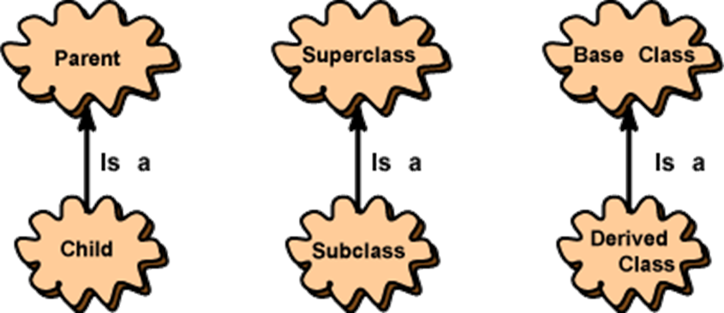
Inheritance – Terminology and Notation
The class that is used to define a new class is called a parent class (or superclass or base class.) The class based on the parent class is called a child class (or subclass or derived class.)
In diagrams, the arrow points from the child to the parent.
Notes:
Inheritance involves a base class and a derived class. The base class is the general class and the derived class is the specialized class. The derived class is based on, or derived from, the base class. You can think of the base class as the parent and the derived class as the child. The child inherits from the parent.
The clouds represent classes. This picture does not show objects.
Inheritance is between classes, not between objects.
There are three sets of phrases for describing inheritance relationships:
parent / child
base class / derived class
superclass / subclass
Programmers use all three sets interchangeably.

Slide 7
Inheritance – Terminology and Notation (2)
Base class (or parent) – inherited from
Derived class (or child) – inherits from the base class
Notation:
class Student // base class
{
. . .
};
class UnderGrad : public Student
{ // derived class
. . .
};

Slide 8
Back to the ‘is a’ Relationship
An object of a derived class 'is a(n)' object of the base class
Example:
an UnderGrad is a Student
a Mammal is an Animal
A derived object has all of the characteristics of the base class
Notes:
Back to the “is-a” relationship: The derived class inherits the member variables and member functions of the base class without any of them being rewritten because an object of the derived class is an object of the base class. For example, an Undergraduate is-a Student; and a Mammal is-an Animal.
However, in addition, new member variables and functions may be added to the derived class to make it more specialized than the base class.

Slide 9
Two Simple Questions (1)
Can a parent class have more than one child class?
Can a parent class inherit characteristics from its child class?
Notes:
Here’s some questions you can ask yourself:
Can a parent class have more than one child class?
Can a parent class inherit characteristics from its child class?

Slide 10
Two Simple Questions (2)
Can a parent class have more than one child class?
Yes, a parent can have any number of children.
In C++ (but not most other object-oriented languages) a child can have more than one parent.
We won’t address multiple inheritance in this course
Can a parent class inherit characteristics from its child class?
No. Inheritance goes in only one direction.
Notes:
The answer to the first question is:
Yes, a parent can have any number of children.
In C++ (but not most other object-oriented languages) a child can have more than one parent.
We won’t address multiple inheritance in this course
The answer to the second is
No. Inheritance goes in only one direction. Children inherit from the parents.
Now, let’s look at how classes can be organized in a hierarchy:

Slide 11
Superclasses and Subclasses
A superclass can have multiple subclasses.
Subclasses can be superclasses of other subclasses.
A big advantage of inheritance is that we can write code that is common to multiple classes once and reuse it in subclasses.
A subclass can define new instance variables and methods, some of which may override (hide) those of a superclass.

Slide 12
Hierarchies
We can organize classes into hierarchies of functionality.
The class at the top of the hierarchy (superclass) defines instance variables and methods common to all classes in the hierarchy.
We derive a subclass, which inherits behavior and fields from the superclass.
Notes:
The picture shows a parent class and a child class, and some objects that have been constructed from each.
These objects are shown as rectangles (to convey the idea that they are more real than the classes, which are only designs).
In the picture, "Joe's car," "Mary's Ford," and "Bob's Ford" represent actual objects.
The cloudy classes represent designs, not actual objects.
Objects are constructed as a program runs.
An object is constructed by following a description in a class file that was created by compiling a C++ source program.

Slide 13
Questions
How many types of automobile are there in the diagram?
How many automobile objects are there in the diagram?

Slide 14
Questions
How many types of automobile are there in the diagram?
Two — the parent type "Automobile" and a child type, "Ford."
How many automobile objects are there in the diagram?
Three.

Slide 15
Hierarchies (2)
This picture shows a hierarchy of classes. It shows that:
"Ford is-a automobile,"
"Nissan is-a automobile,"
"VW is-a automobile."
It also shows that "Sentra is-a Nissan."
Notes:
This picture shows a hierarchy of classes.
It shows that "Ford is-a automobile," "Nissan is-a automobile," and that "VW is-a automobile."
It also shows that "Sentra is-a Nissan."
In a hierarchy, each class might have several child classes. The class at the top of the hierarchy has no parent. This class is called the root of the hierarchy.
A class may be the parent for a child class and may be a child of another class. Just as with human relationships, a person is a child of some humans and a parent to others.

Slide 16
What Does a Child Have?
An object of the derived class has:
all members defined in child class
all members declared in parent class
An object of the derived class can use:
all public members defined in child class
all public members defined in parent class

Slide 17
Video Example
Notes:
Object-oriented programming consists mostly of creating class hierarchies and instantiating objects from them.
We’ll look at a class named Video to represent videos available on a streaming service. Then we’ll look at how we can use inheritance to give additional functionality to different types of videos.

Slide 18
class Video
Suppose we have a class Video to represent videos available from a streaming service. The UML diagram might look like this:
Video
- title : string - length : integer - avail : Boolean
+ displayInfo() : void
Notes:
The Video class has basic information in it, and could be used for documentaries and instructional videos. But more information is needed for movie videos. Let’s make a class that is similar to Video, but now includes the name of the director and a rating.

Slide 19
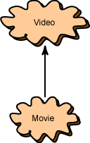
Using Inheritance
The Video class has basic information in it, and could be used for documentaries and instructional videos. But more information is needed for movie videos. Let us make a class that is similar to Video, but now includes the name of the director and a rating.
Movie
- title : string - length : integer - avail : Boolean - director: string - rating : string | Inherited from Video Inherited from Video Inherited from Video Defined in Movie Defined in Movie
+ displayInfo() : void | Inherited from Video
Notes:
The class Movie is a subclass of Video. An object of type Movie has the additional members you see here, director and rating.

Slide 20
Using Inheritance (2)
The class Movie is a subclass of Video. An object of type Movie has these members:
Both classes are defined: the Video class can be used to construct objects of that type, and now the Movie class can be used to construct objects of the Movie type.
Movie
- title : string - length : integer - avail : Boolean - director: string - rating : string | Inherited from Video Inherited from Video Inherited from Video Defined in Movie Defined in Movie
+ displayInfo() : void | Inherited from Video
Notes:
Both classes are defined: the Video class can be used to construct objects of that type, and now the Movie class can be used to construct objects of the Movie type.

Slide 21
Instantiating these classes
We can make instances of these classes now.
A video might have:
Title: “Pandemic: How to Prevent an Outbreak”
Length: 50
A movie might have:
Title: “The Princess Bride”
Length: 98
Director: “Rob Reiner”
Rating: “PG”
Notes:
We can make instances of these classes now.
A video might have:
Title: “Pandemic: How to Prevent an Outbreak”
Length: 50 minutes
A movie might have:
Title: “The Princess Bride”
Length: 98 minutes
Director: “Rob Reiner”
Rating: “PG”

Slide 22
Overriding Methods
Video does not define the instance variables director and rating, so its displayInfo() method can't use them to display those.
We need a new displayInfo() method in the class Movie
A child's method overrides a parent's method when it has the same signature as a parent method. Now the parent has its method, and the child has its own method with the same signature.
Movie
- title : string - length : integer - avail : Boolean - director: string - rating : string | Inherited from Video Inherited from Video Inherited from Video Defined in Movie Defined in Movie
+ displayInfo() : void | Inherited from Video
Defined in Movie
Notes:
Because the class Video does not define the instance variables director and rating, its displayInfo() method can't use them.
We need a new displayInfo() method in the class Movie:
<click>
Now, even though the parent has a displayInfo() method, the new definition of displayInfo() in the child class will override the parent's version.
A child's method overrides a parent's method when it has the same signature as a parent method. Now the parent has its method, and the child has its own method with the same signature. (Remember that the signature of a method is the name of the method and its parameter list.)

Slide 23
Redefining Base Class Functions
Not the same as overloading – with overloading, parameter lists must be different
Objects of base class use base class version of function; objects of derived class use derived class version of function
Notes:
Understand that Overriding is not the same as overloading: with overloading, parameter lists must be different.
An object of the parent type uses the method given in the parent's definition. An object of the child type uses the method given in the child's definition.

Slide 24
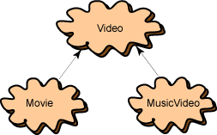
Another Derived Class
So far the video streaming application has two classes: Video and Movie.
Say that you wanted to create a new class, MusicVideo that will be like Video but will have two new instance variables: artist and genre ("R&B", "Pop", "Country", "Other" ).
Both of these will be Strings. The MusicVideo class will need its own displayInfo() method.
Notes:
So far the video rental application has two classes: Video and Movie.
Say that you wanted to create a new class, MusicVideo that will be like Video but will have two new instance variables: artist and genre ("R&B", "Pop", "Classical", "Other" ).
Both of these will be Strings. The MusicVideo class will need its own displayInfo() method.

Slide 25
Adding Attributes
The MusicVideo class is a subclass of Video.
It adds the member variables artist and genre
As before, we also will need a new displayInfo() method for the MusicVideo class
MusicVideo
- title : string - length : integer - avail : Boolean - artist: string - genre : string | Inherited from Video Inherited from Video Inherited from Video Defined in MusicVideo Defined in MusicVideo
+ displayInfo() : void | Inherited from Video
Defined in MusicVideo
Notes:
iThe MusicVideo class is a subclass of Video. It adds the member variables artist and genre
Notice that MusicVideo inherits only from its parent Video. It does not inherit anything from its sibling class Movie.
You may have noticed a design flaw in the definitions of these classes — none has a price! Say that it was your job to fix this problem. What changes will you make?
Since all videos have a rental cost, the fixes should be made to the parent class Video. A new variable rent should be added to the parent class. Then add a getRentalCost() method. The two child classes will inherit all these changes. Fixing the parent class fixes all of its children.
This has been a introduction to the concept of inheritance. Look for other videos that explain the C++ syntax necessary to implement these concepts.

Slide 26
C++ Example
GradedActivity.h
GradedActivity.cpp
driver1.cpp
Notes:
Let’s look at an example of how inheritance can be used. Most teachers assign various graded activities for their students to complete. A graded activity can receive a numeric score such as 70, 85, 90, and so on, and a letter grade such as A, B, C, D, or F. The following GradedActivity class is designed to hold the numeric score and letter grade of a
graded activity. When a numeric score is stored by the class, it automatically determines
the letter grade.

Slide 27
C++ Example (1)
GradedActivity.h
GradedActivity.cpp
driver1.cpp
Notes:
The GradedActivity class has a default constructor that initializes the score member variable to 0.0. A second constructor accepts an argument for score . The setScore member function also accepts an argument for the score variable, and the getLetterGrade member function returns the letter grade that corresponds to the value in score .

Slide 28
C++ Example (2)
GradedActivity.h
GradedActivity.cpp
FinalExam.h
FinalExam.cpp
Driver2.cpp
Notes:
The GradedActivity class represents the general characteristics of a student’s graded activity.
Many different types of graded activities exist, however, such as quizzes, midterm exams, final exams, lab reports, essays, and so on. Because the numeric scores might be determined differently for each of these graded activities, we can create derived classes to handle each one. For example, FinalExam.h shows the FinalExam class, which is derived from the GradedActivity class. It has member variables for the number of questions on the exam (numQuestions ), the number of points each question is worth ( pointsEach ), and the number of questions missed by the student ( numMissed ).

Slide 29
C++ Example (3)
GradedActivity.h
GradedActivity.cpp
FinalExam.h
FinalExam.cpp
Driver2.cpp
Notes:
The GradedActivity class represents the general characteristics of a student’s graded activity.
Many different types of graded activities exist, however, such as quizzes, midterm exams, final exams, lab reports, essays, and so on. Because the numeric scores might be determined differently for each of these graded activities, we can create derived classes to handle each one. For example, FinalExam.h shows the FinalExam class, which is derived from the GradedActivity class. It has member variables for the number of questions on the exam (numQuestions ), the number of points each question is worth ( pointsEach ), and the number of questions missed by the student ( numMissed ).

Slide 30
Protected Members and Class Access

Slide 31
Protected Members and Class Access
protected member access specification: like private, but accessible by objects of derived class
Class access specification: determines how private, protected, and public members of base class are inherited by the derived class

Slide 32
Class Access Specifiers
public – object of derived class can be treated as object of base class (not vice-versa)
protected – more restrictive than public, but allows derived classes to know details of parents
private – prevents objects of derived class from being treated as objects of base class.

Slide 33
Inheritance vs. Access
How inherited base class members
appear in derived class
Base class members
private: x
protected: y
public: z
private
base class
x is inaccessible
private: y
private: z
private: x
protected: y
public: z
protected
base class
x is inaccessible
protected: y
protected: z
Most derived classes created when learning to program use public inheritance.
private: x
protected: y
public: z
public
base class
x is inaccessible
protected: y
public: z

Slide 34
More Inheritance vs. Access
class Grade
class Test : public Grade
private members:
char letter;
float score;
void calcGrade();
public members:
void setScore(float);
float getScore();
char getLetter();
private members:
int numQuestions;
float pointsEach;
int numMissed;
public members:
Test(int, int);
private members:
int numQuestions:
float pointsEach;
int numMissed;
public members:
Test(int, int);
void setScore(float);
float getScore();
char getLetter();
When Test class inherits
from Grade class using
public class access, it looks like this:

Slide 35
More Inheritance vs. Access (2)
class Grade
class Test : protected Grade
private members:
char letter;
float score;
void calcGrade();
public members:
void setScore(float);
float getScore();
char getLetter();
private members:
int numQuestions;
float pointsEach;
int numMissed;
public members:
Test(int, int);
private members:
int numQuestions:
float pointsEach;
int numMissed;
public members:
Test(int, int);
protected members:
void setScore(float);
float getScore();
float getLetter();
When Test class inherits
from Grade class using
protected class access, it looks like this:

Slide 36
More Inheritance vs. Access (3)
class Grade
class Test : private Grade
private members:
char letter;
float score;
void calcGrade();
public members:
void setScore(float);
float getScore();
char getLetter();
private members:
int numQuestions;
float pointsEach;
int numMissed;
public members:
Test(int, int);
private members:
int numQuestions:
float pointsEach;
int numMissed;
void setScore(float);
float getScore();
float getLetter();
public members:
Test(int, int);
When Test class inherits
from Grade class using
private class access, it looks like this:

Slide 37
Constructors & Destructors in Base and Derived Classes
Notes:
3:00 CLASS STARTS HERE

Slide 38
Constructors and Destructors in Base and Derived Classes
Derived classes can have their own constructors and destructors
When an object of a derived class is created, the base class’s constructor is executed first, followed by the derived class’s constructor
When an object of a derived class is destroyed, its destructor is called first, then that of the base class

Slide 39
Constructor & Destructor example
See constructors-destructors.cpp

Slide 40
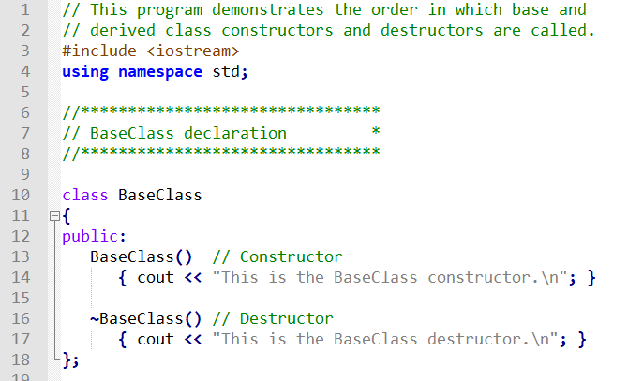
Constructors and Destructors in Base and Derived Classes (2)

Slide 42
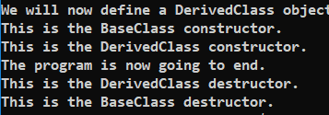
Program Output

Slide 43
Passing Arguments to Base Class Constructor
Allows selection between multiple base class constructors
Specify arguments to base constructor on derived constructor heading:
Square::Square(int side) : Rectangle(side, side)
Must be done if base class has no default constructor

Slide 44
Passing Arguments to Base Class Constructor (2)
derived class constructor
base class constructor
Square::Square(int side):Rectangle(side,side)
derived constructor parameter
base constructor parameters

Slide 45
See
Rectangle.h
Cube.h
cube.cpp

Slide 46
Polymorphism and Virtual Member Functions

Slide 47
Polymorphism
Polymorphism refers to the ability to associate multiple meanings with one function name using a mechanism called late binding
Polymorphism is a key component of the philosophy of object oriented programming

Slide 48




Subtype polymorphism
Person (parent / base class)
AKA subclassing or inheritance
Canadian (child / derived class)
Swiss (child / derived class)
French (child / derived class)
Notes:
subtyping allows a function to be written to take an object of a certain type T, but also work correctly, if passed an object that belongs to a type S that is a subtype of T (according to the Liskov substitution principle)

Slide 49
Subtype polymorphism helps to provide simple interfaces
We only need to know one method to use with an unknown number of sub-classes.
E.g. Person::hello(), defined by default as “Bonjour!”
With polymorphism, we can use the People lens to look at each person and not have to worry about what subtype of Person they are.
Because every Person can do hello().
However, this might not be very useful if we can only do what the parent class does by default.
Do all people do hello in the same way?

Slide 50
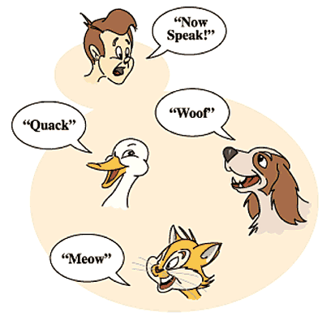
Speak!
Same command!
void NowSpeak(const Animal& animal) {
animal.speak();
}
Results differ based on the type of animal.
Image source: arbabwaseer@gmail.com
Notes:
subtyping allows a function to be written to take an object of a certain type T, but also work correctly, if passed an object that belongs to a type S that is a subtype of T (according to the Liskov substitution principle)
Suppose we don’t know what subtype of Animal it is, we only know it is an Animal
What sound does an animal make by default?

Slide 51
Polymorphism is Useful
What if we want to use the derived version instead of the base version?
the Canadian version of hello(), instead of the Person version
The Duck version of speak(), instead of the Animal version
There needs to be a way to indicate that the derived version should override the parent version.
When the person says “Now Speak”, each animal should speak according to what type of animal it is.
With polymorphism, we can indicate a method (e.g. speak) and it will do what is appropriate for that type (e.g. “quack”, “meow”, “woof”).
Notes:
Or, the British Columbian version instead of that…
Or the mandarin duck version…

Slide 52
Subtype polymorphism (2)
class Pet {
public:
virtual void speak() = 0;
};
class Dog : public Pet {
public:
void speak() { cout << "Woof" << endl; }
};
class Cat : public Pet {
public:
void speak() { cout << "Meow" << endl; }
};
class Duck : public Pet {
public:
void speak() { cout << "Quack" << endl; }
};
void NowSpeak(Pet& pet) {
pet.speak();
}
AKA subclassing or inheritance
Inheritance example:
cout << "Now Speak!" << endl;
cout << " dog: "; NowSpeak(dog);
cout << " cat: "; NowSpeak(cat);
cout << "duck: "; NowSpeak(duck);
Now Speak!
dog: Woof
cat: Meow
duck: Quack

Slide 53
A Late Binding Example
Imagine a graphics program with several types of figures
Each figure may be an object of a different class, such as a circle, oval, rectangle, etc.
Each is a descendant of a class Figure
Each has a function draw( ) implemented with code specific to each shape
Class Figure has functions common to all figures

Slide 54
A Problem
Suppose that class Figure has a function center()
Function center() moves a figure to the center of the screen by erasing the figure and redrawing it in the center of the screen
Function center() is inherited by each of the derived classes
Function center() uses each derived object's draw function to draw the figure
The Figure class does not know about its derived classes, so it cannot know how to draw each figure

Slide 55
Virtual Functions
Because the Figure class includes a method to draw figures, but the Figure class cannot know how to draw the figures, virtual functions are used
Making a function virtual tells the compiler that you don't know how the function is implemented and to wait until the function is used in a program, then get the implementation from the object.
This is called late binding

Slide 56
Virtual functions mark which functions can be overridden by a derived class
Indicate in the base that the derived version should be used instead if base version is also available.
In C++ this is known as a virtual function
When looking at a method invocation on an instance of a base class and the compiler sees a virtual method, it knows to look for the derived class version of the function.
If the derived class does not have its own version, it will use the base class version.
virtual void speak();
Notes:
4:10 and 5:45 start here

Slide 57
Virtual Functions in C++
As another example, let's design a record-keeping program for an auto parts store
We want a versatile program, but we do not know all the possible types of sales we might have to account for
Later we may add mail-order and discount sales
Functions to compute bills will have to be added later when we know what type of sales to add
To accommodate the future possibilities, we will make the bill() function a virtual function

Slide 58
The Sale Class
All sales will be derived from the base class Sale
The bill() function of the Sale class is virtual
The member function savings() and operator < each use bill()
The Sale class interface and implementation are shown in sale.h and sale.cpp

Slide 59
Sale.h
class Sale
{
public:
Sale();
Sale(double thePrice);
virtual double bill() const;
double savings(const Sale& other) const;
//Returns the savings if you buy other instead of the calling object.
protected:
double price;
};
bool operator < (const Sale& first, const Sale& second);
//Compares two sales to see which is larger.

Slide 60
Sale.cpp
#include "sale.h"
Sale::Sale()
{ price = 0.0;}
Sale::Sale(double thePrice)
{ price = thePrice; }
double Sale::bill() const
{ return price; }
double Sale::savings(const Sale& other) const
{ return ( bill() - other.bill() ); }
bool operator < (const Sale& first, const Sale& second)
{ return (first.bill() < second.bill()); }

Slide 61
Virtual Function bill
Because function bill() is virtual in class Sale, function savings() and operator <, defined only in the base class, can in turn use a version of bill() found in a derived class
When a DiscountSale object calls its savings() function, defined only in the base class, function savings() calls function bill()
Because bill() is a virtual function in class Sale, C++ uses the version of bill() defined in the object that called savings()

Slide 62
DiscountSale::bill
Class DiscountSale has its own version of virtual function bill()
Even though class Sale is already compiled, Sale::savings() and Sale::operator< can still use function bill() from the DiscountSale class
The keyword virtual tells C++ to wait until bill() is used in a program to get the implementation of bill() from the calling object
DiscountSale is defined and used in
Discountsale.h
Discountsale.cpp

Slide 63
class DiscountSale : public Sale
{
public:
DiscountSale();
DiscountSale(double thePrice, double theDiscount);
//Discount is expressed as a percent of the price.
virtual double bill() const;
protected:
double discount;
};

Slide 64
DiscountSale::DiscountSale() : Sale(), discount(0)
{}
DiscountSale::DiscountSale(double thePrice, double theDiscount)
: Sale(thePrice), discount(theDiscount)
{}
double DiscountSale::bill() const
{
double fraction = discount/100;
return (1 - fraction)*price;
}

Slide 65
int main()
{
Sale simple(10.00); //One item at $10.00.
DiscountSale discount(11.00, 10); //One item at $11.00 with a 10% discount.
cout.setf(ios::fixed); cout.setf(ios::showpoint); cout.precision(2);
if (discount < simple)
{
cout << "Discounted item is cheaper.\n";
cout << "Savings is $" << simple.savings(discount) << endl;
}
else
cout << "Discounted item is not cheaper.\n";
return 0;
}

Slide 66
Polymorphism and Virtual Member Functions
Virtual member function: function in base class that expects to be redefined in derived class
Function defined with key word virtual:
virtual void Y() {...}
Supports dynamic binding: functions bound at run time to function that they call
Without virtual member functions, C++ uses static (compile time) binding
Notes:
3:00 Start here

Slide 67
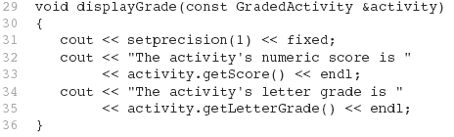
Consider this function (from PassFailDemo2.cpp)
Because the parameter in the displayGrade function is a GradedActivity reference variable, it can reference any object that is derived from GradedActivity.
A problem occurs in PassFailDemo2, however...
Notes:
Because the parameter in the displayGrade function is a GradedActivity reference variable, it can reference any object that is derived from GradedActivity . A problem can occur with this type of code, however, when redefined member functions are involved.

Slide 68
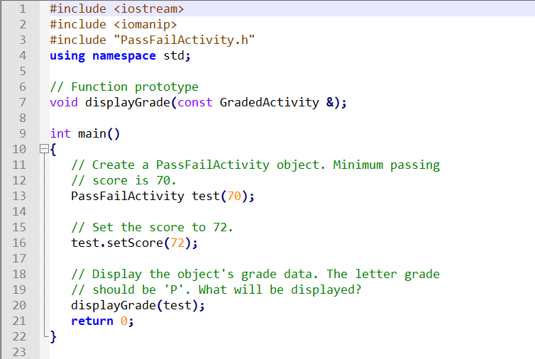
PassFailDemo2.cpp
Notes:
This code creates a PassFailActivity object and passes it to displayGrade

Slide 69
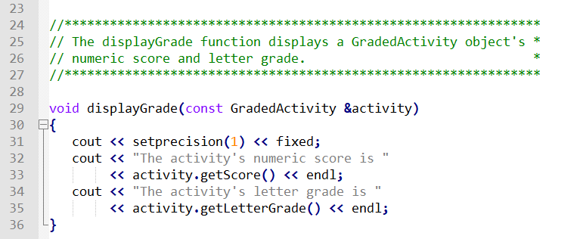

PassFailDemo2.cpp (cont’d)
The getLetterGrade member function returned ‘C’ instead of ‘P’.
GradedActivity class’s getLetterGrade function was executed instead of the PassFailActivity class’s version of the function.
Notes:
Recall that the PassFailActivity class is derived from the GradedActivity class. The PassFailActivity class redefines the getLetterGrade function. Although we can pass a PassFailActivity object as an argument to the displayGrade function, we will not get the results we wish.

Slide 70
Static Binding
PassFailDemo2 displays 'C' instead of 'P' because the call to the getLetterGrade function is statically bound (at compile time) with the GradedActivity class's version of the function.
We can remedy this by making the function virtual.
Notes:
As you can see from the example output, the getLetterGrade member function returned ‘C’ instead of ‘P’. This is because the GradedActivity class’s getLetterGrade function was executed instead of the PassFailActivity class’s version of the function. In PassFailDemo2, C++ decides at compile time which version of the getLetterGrade function to execute when it encounters the call to the function in line 35. Even though we passed a PassFailActivity object to the displayGrade function, the activity parameter in the displayGrade function is a GradedActivity reference variable.
To remedy this, the getLetterGrade function can be made virtual . A virtual function is a member function that is dynamically bound to function calls.

Slide 71
Virtual Functions (2)
A virtual function is dynamically bound to calls at runtime.
At runtime, C++ determines the type of object making the call, and binds the function to the appropriate version of the function.
Notes:
In dynamic binding , C++ determines which function to call at runtime, depending on the type of the object responsible for the call. If a GradedActivity object is responsible for the call, C++ will execute the GradedActivity::getLetterGrade function. If a PassFailActivity object is responsible for the call, C++ will execute the PassFailActivity::getLetterGrade function.

Slide 72
Virtual Functions (3)
To make a function virtual, place the virtual key word before the return type in the base class's declaration: virtual char getLetterGrade() const;
The compiler will not bind the function to calls. Instead, the program will bind them at runtime.
Notes:
Virtual functions are declared by placing the key word virtual before the return type in the base class’s function declaration, such as
virtual char getLetterGrade() const;
This declaration tells the compiler to expect getLetterGrade to be redefined in a derived class. The compiler does not bind calls to the function with the actual function. Instead, it allows the program to bind calls, at runtime, to the version of the function that belongs to the same class as the object responsible for the call.

Slide 73
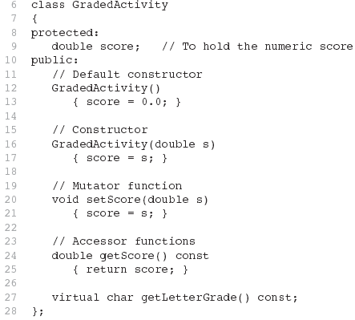
Updated Version of GradedActivity
The function is now virtual.
The function also becomes virtual in all derived classes automatically!
Notes:
NOTE: You place the virtual key word only in the function’s declaration or prototype. If the function is defined outside the class, you do not place the virtual key word in the function header. (The code is stored on github under Inheritance/GradedActivity Version 3) The only change we have made to this class is to declare getLetterGrade as virtual in line 27. This tells the compiler not to bind calls to getLetterGrade with the function at compile time. Instead, calls to the function will be bound dynamically to the function at runtime.

Slide 74
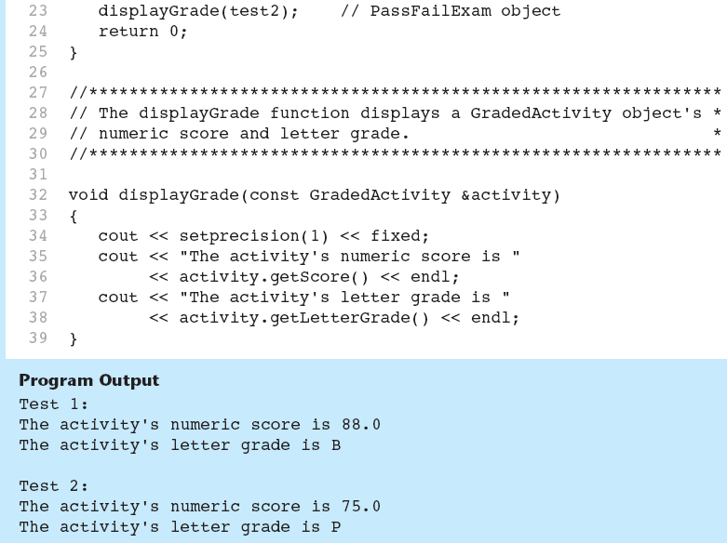
Updated Version of GradedActivity
Notes:
Now that the getLetterGrade function is declared virtual , the program works properly. This type of behavior is known as polymorphism.

Slide 75
Polymorphism Requires References or Pointers
Polymorphic behavior is only possible when an object is referenced by a reference variable or a pointer, as demonstrated in the displayGrade() function.
Notes:
The displayGrade function in PassFailDemo uses a GradedActivity reference variable as its parameter. When we call the function, we pass an object by reference. Polymorphic behavior is not possible when an object is passed by value, however.

Slide 76

Base Class Pointers
Can define a pointer to a base class object
Can assign it the address of a derived class object
See PassFailDemo3.cpp
Notes:
Pointers to a base class may be assigned the address of a derived class object. For example, look at the following code:
GradedActivity *exam = new PassFailExam(100, 25, 70.0);
This statement dynamically allocates a PassFailExam object and assigns its address to exam , which is a GradedActivity pointer. We can then use the exam pointer to call member functions, as shown here:
cout << exam->getScore() << endl;
cout << exam->getLetterGrade() << endl;

Slide 77
Base Class Pointers (2)
Base class pointers and references only know about members of the base class
So, you can’t use a base class pointer to call a derived class function
Redefined functions in derived class will be ignored unless base class declares the function virtual
Notes:
Although a base class pointer can reference objects of any class that derives from the base class, there are limits to what the pointer can do with those objects. Recall that the GradedActivity class has, other than its constructors, only three member functions: setScore , getScore , and getLetterGrade . So, a GradedActivity pointer can be used to call only those functions, regardless of the type of object it points to.

Slide 78
Redefining vs. Overriding
In C++, redefined functions are statically bound and overridden functions are dynamically bound.
So, a virtual function is overridden, and a non-virtual function is redefined.
Notes:
Earlier in this module you learned how a derived class can redefine a base class member function. When a class redefines a virtual function, it is said that the class overrides the function. In C++, the difference between overriding and redefining base class functions is that overridden functions are dynamically bound, and redefined functions are statically bound. Only virtual functions can be overridden.

Slide 79
Virtual Destructors
It's a good idea to make destructors virtual if the class could ever become a base class.
Otherwise, the compiler will perform static binding on the destructor if the class ever is derived from.
Notes:
When you write a class with a destructor, and that class could potentially become a base class, you should always declare the destructor virtual . This is because the compiler will perform static binding on the destructor if it is not declared virtual . This can lead to problems when a base class pointer or reference variable references a derived class object. If the derived class has its own destructor, it will not execute when the object is destroyed or goes out of scope. Only the base class destructor will execute.

Slide 80
C++17's override and final Key Words
The override key word tells the compiler that the function is supposed to override a function in the base class. virtual void functionA(int arg) const override
When a member function is declared with the final key word, it cannot be overridden in a derived class.
virtual void message() const final;
Notes:
To make sure that a member function in a derived class overrides a virtual member function in a base class, you can use the override key word in the derived class’s function prototype (or the function header, if the function is written inline). The override key word tells the compiler that the function is supposed to override a function in the base class. It will cause a compiler error if the function does not actually override any functions.
In some derived classes, you might want to make sure that a virtual member function cannot be overridden any further down the class hierarchy. When a member function is declared with the final key word, it cannot be overridden in a derived class. If a derived class attempts to override a final member function, the compiler generates an error.

Slide 81
Abstract methods do not have default implementations
Suppose there is not a meaningful version to use in the base class?
Indicate that the method is abstract.
In C++ this is called a pure virtual function.
When looking at a method invocation on an instance of a base class and the compiler sees a pure virtual method, it knows it must use the derived version.
If the derived class does not have its own version, it will not compile.
virtual void speak() = 0;
Notes:
Like Animal::speak() - what does the <default Animal> say?
Pure virtual:
virtual T foo(…) = 0;
This is like setting the function pointer to nullptr. It has a name and arguments but its value is null, so it cannot be dereferenced.

Slide 82
Abstract Class
An abstract class cannot be instantiated!
In C++ this is accomplished by having a pure virtual function in the base class.
This makes sense.
If you have a pure virtual function, there is no definition for that function, so the object cannot be created.
Derived classes that will be instantiated MUST each define their own version of the pure virtual function(s) in the base class.
Notes:
Abstract classes represent objects which should not be instantiated – objects which don’t have meaningful default instances.
An abstract class can be thought of as defining the interface for the derived classes: what must actions and attributes must every subtype support?

Slide 83
Virtual Details
To define a function differently in a derived class and to make it virtual
Add keyword virtual to the function declaration in the base class
virtual is not needed for the function declaration in the derived class, but is often included
virtual is not added to the function definition
Virtual functions require considerable overhead so excessive use reduces program efficiency

Slide 84
Guidelines for subtype polymorphism
If you want derived classes to have the option of overriding a function since a default is provided.
Make it virtual
If you want to force derived classes to override a function (i.e. do not provide a default)
Make it pure virtual
You cannot instantiate an abstract class.
Use references and pointers.

